Slide 1

Guru Ghasidas Vishwvidhyalaya
Bilaspur (C.G.)
SESSION 2021-22
A
PRESENTATION ON
“PARKINSON'S DISEASE DETECTION USING MACHINE LEARNING”
PRESENTED TO PRESENTED BY
Dr. VIKAS PANDEY sir TUSHAR AWASTHI
Ass. Professor
GGV Bilaspur

Slide 2
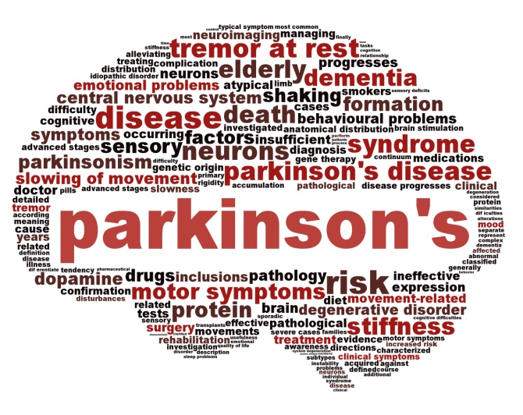

INTRODUCTION
Parkinson’s disease (PD) is one of the major public health problems in the world. It is a well-known fact that around five million people suffer from Parkinson’s disease in the worldwide.
Thus, it is important to predict Parkinson’s disease in early stages so that early plan for the necessary treatment can be made.
Diagnosis of the Parkinson disease through machine learning approaches provides better understanding from PD dataset in the present decade.

Slide 3
Parkinson’s disease is a progressive disorder that affects movement leading to shaking, stiffness and difficulty with walking balance and coordination.
This is the one of the important project in machine learning because it comes under healthcare domain and healthcare is one of those fields where machine learning can contribute a lot.
Parkinson affects a mostly people who are more than 50 years of age so there are also cases when people below that age also get affected with it.
The main cause of Parkinson’s disease is actually unknown.
Parkinson’s disease is treated as disorder of the central nervous system which is the result of loss of cells from various parts of the brain.

Slide 4
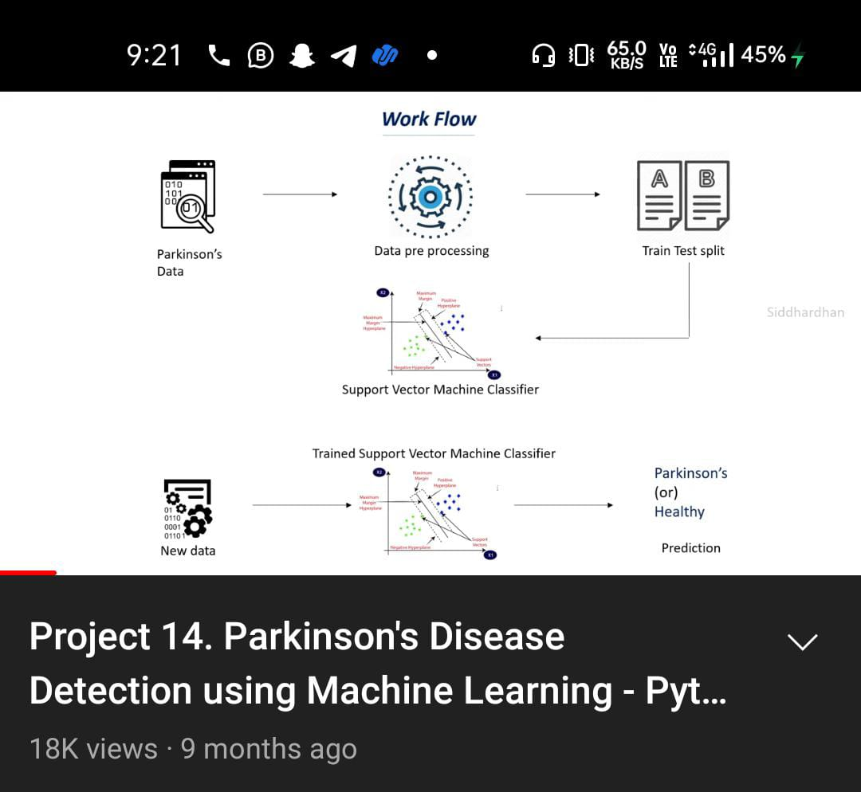
WORK FLOW:
The first thing that we need in machine learning is the data which we use to train our machine learning model. So for this we need the Parkinson’s data, the data which contains certain details about the patients who has Parkinson’s and those patients who doesn’t have Parkinson’s.
once we have this data we need to process this data so we cannot feed the raw data to out machine learning model so we need to do some processing
once we do the processing we need to split this data to training data and test data

Slide 5
WORK FLOW
we split this data into training data and testing data and we use this training data to train our machine learning model so this is where our machine learning model will understand about the data.
for this particular projects we are going to use a support vector machine model or a support vector machine classifier. So once we train this support vector machine model with the training data, we will then evaluate this model to find how this model is working, what is the performance of this model using the test data.
So this is the reason why we splitting the data into training data and testing data, the training data is used for the training the model and the test data is used for evaluating our model.
Traning data
Testing data
Traning data
Testing data

Slide 6
Once we evaluate the model we will have a trained support vector machine model so when you give new data this particular model can detect whether a person has Parkinson or not

Slide 7
RESEARCH WORK and DATASET INFO:
Different researchers have used different features and data to predict Parkinson’s disease. We have used biomedical voice of human as the main feature.
The voice dataset for Parkinson disease has been retrieved from UCI Machine learning repository from Centre for Machine Learning and Intelligent Systems.
This dataset is composed of a range of biomedical voice measurements from 31 people, 23 with Parkinson's disease (PD).
Each column in the table is a particular voice measure, and each row corresponds one of 195 voice recording from these individuals ("name" column).

Slide 8
The main aim of the data is to discriminate healthy people from those with PD, according to "status" column which is set to 0 for healthy and 1 for PD.
The data is in ASCII CSV format.
The rows of the CSV file contain an instance corresponding to one voice recording. There are around six recordings per patient the name of the patient is identified in the first column.

Slide 9
The following are the Attribute Information:
name:
ASCII subject name and recording number
MDVP:Fo(Hz)
Average vocal fundamental frequency
MDVP:Fhi(Hz), MDVP:Flo(Hz), MDVP:Jitter(%), MDVP:Jitter(Abs), MDVP:RAP, MDVP:PPQ, Jitter:DDP
Several measures of variation in fundamental frequency
MDVP:Shimmer, MDVP:Shimmer(dB), Shimmer:APQ3, Shimmer:APQ5, MDVP:APQ, Shimmer:DDA
Several measures of variation in amplitude
NHR, HNR
Two measures of ratio of noise to tonal components in the voice
status
Health status of the subject
(one) - Parkinson's
(zero) - healthy
RPDE,D2
Two nonlinear dynamical complexity measures
DFA
Signal fractal scaling exponent
Spread1, spread2, PPE
Three nonlinear measures of fundamental frequency variation

Slide 10
MATERIALS AND METHODS
A flowchart of the proposed analysis is shown in next Slide.
The data was first collected and the required non-motor and biomarker features are then extracted.
Then different machine learning algorithms are employed for the classification task.
Finally, a comparative analysis is made based on the accuracy provided by different machine learning models.

Slide 11
Flow Chart
DATA COLLECTION
The data used in the study are from Parkinson's Progression Markers Initiative (PPMI)
DATA PROCESSING
Split data into training data
Split data into test data
MACHINE LEARNING CLASSIFIRE
Support Vector Machine
ANALYSING RESULT
Various performance measures are computed for each of the models and the best one are chosen

Slide 12
DATABASE
In this study the data from Parkinson’s Progression Markers Initiative (PPMI) database was obtained.
PPMI is an observational, multicentre study that collects clinical and imaging data and biologic samples from various cohorts that can be used by researchers to establish markers of disease progression in PD.
In this study these features have been used because we felt that they are a good combination of non-motor features and biomarkers. The details of these features are given in next section.

Slide 13
REQUIREMENT SPECIFICATION
A Software Requirements Specification (SRS) is a description of particular software product, program or set of programs that performs a set of functions in a target environment (IEEE Std. 830-1993).
Purpose: The purpose of software requirements specification specifies the intentions and intended audience of the SRS
Scope: The scope of the SRS identifies the software product to be produced, the capabilities, application, relevant objects etc. We are proposed to implement Passive Aggressive Algorithm which takes the test and trained data set from the cancer data set.

Slide 14
Definitions, Acronyms and Abbreviations Software Requirements Specification: It’s a description of a particular software product, program or set of programs that performs a set of function in target environment.
References: IEEE Std. 830-1993, IEEE Recommended Practice for Software Requirements Specifications thy Sierra and Bert Bates.
Overview: The SRS contains the details of process, DFD’s, functions of the product, user characteristics. The non-functional requirements if any are also specified.
Overall description: The main functions associated with the product are described in this section of SRS. The characteristics of a user of this product are indicated. The assumptions in this section result from interaction with the project stakeholders.

Slide 15
SYSTEM REQUIREMENTS
Hardware Requirements:
Processor : above 500 MHz
Ram : 4 GB
Disk : 4 GB
Input device : Standard Keyboard and Mouse.
Output device : VGA and High Resolution Monitor.
Software Requirements:
Operating System : Windows 7 or higher
Programming : Python 3.6 and related libraries
Software : Google Colab, Anaconda - Jupyter

Slide 16
IMPLEMENTATION
Install the required packages for building the ‘Passive Aggressive Classifier’.
Load the libraries into the workspace from the packages.
Read the input data set.
Normalize the given input dataset.
Divide this normalized data into two parts: a. Train data b. Test data (Note: 80% of Normalized data is used as Train data, 20% of the Normalized data is used as Test data.)

Slide 17
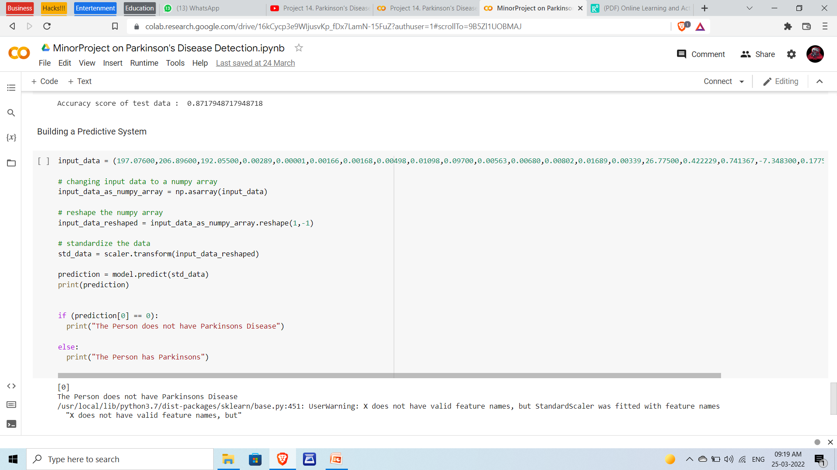
SCREENSHOTS
Output of Predictive System in Google Colab

Slide 18
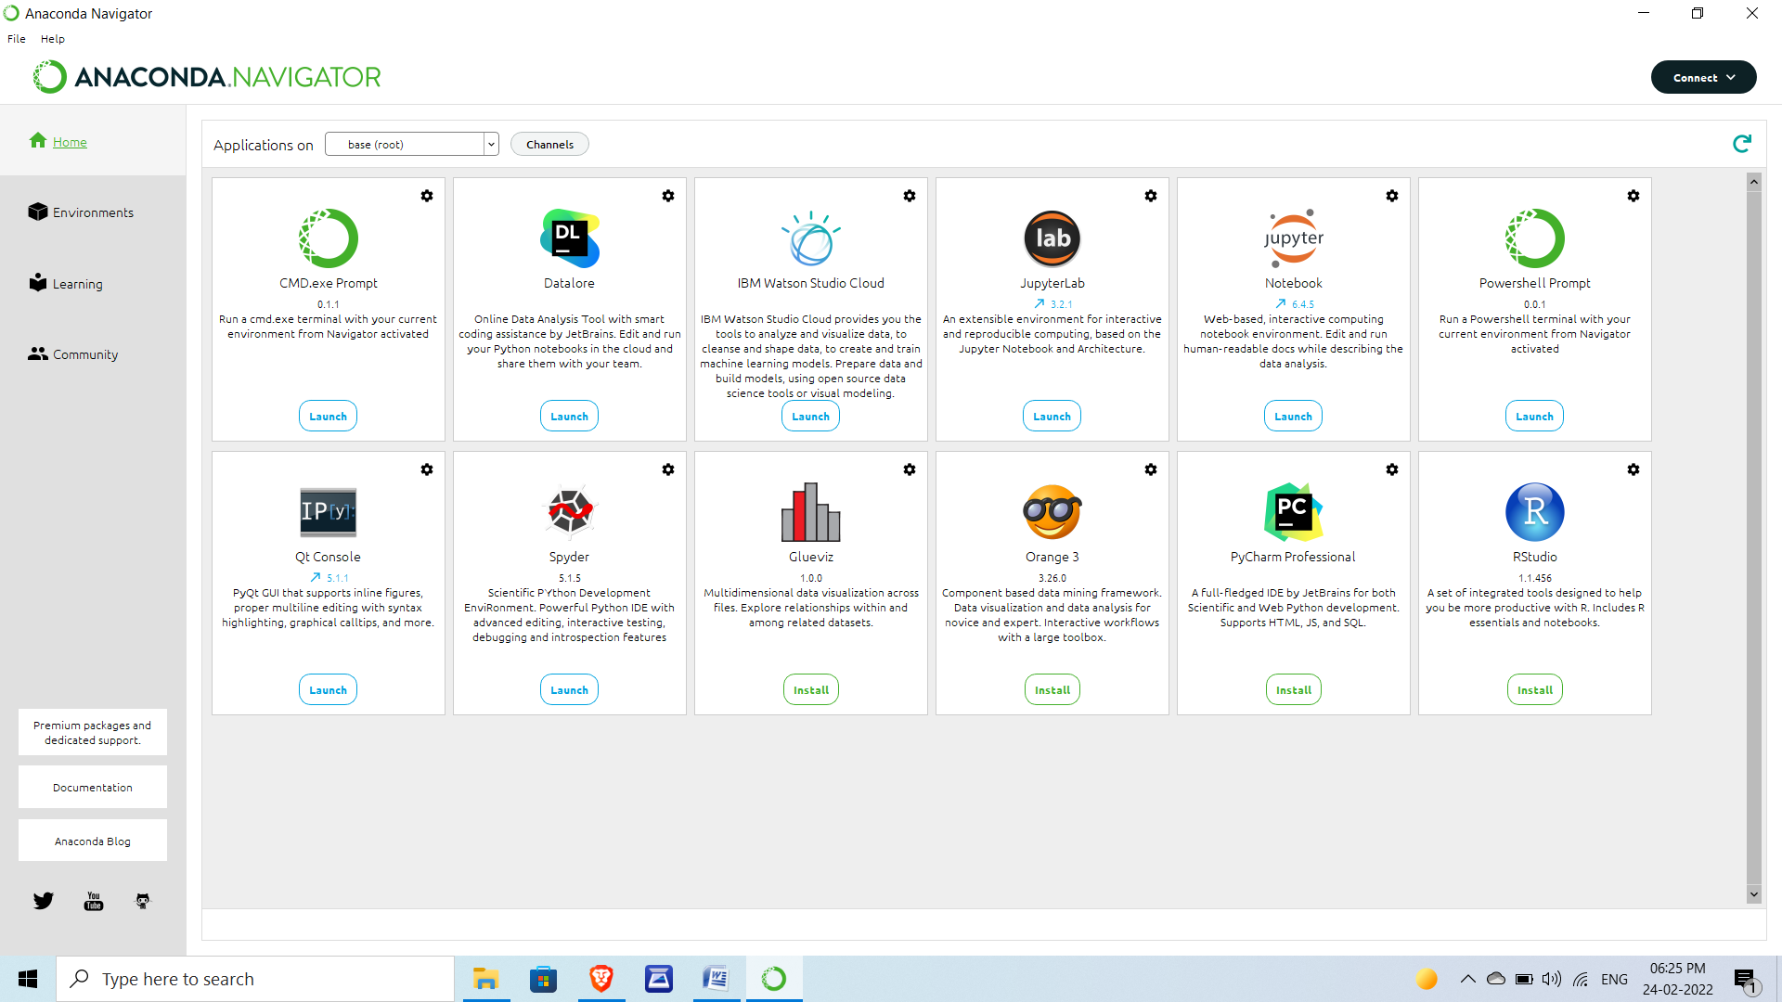
Another s/w Anaconda Navigator

Slide 19
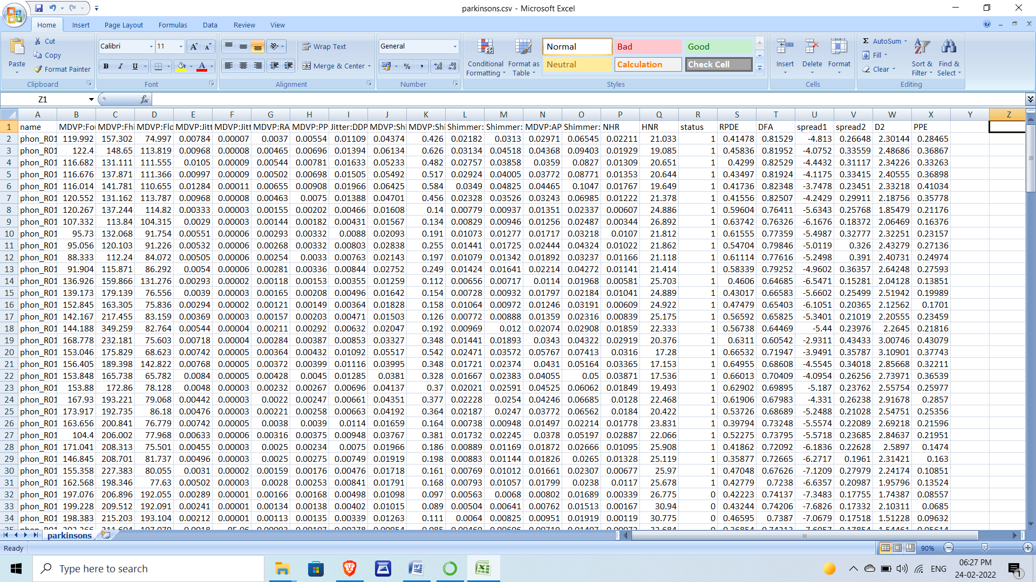
Dataset of Parkinson’s Project

Slide 20
TESTING
UNIT TESTING: It is the level of software testing where individual units and the components are tested. In the proposed project the data of an individual person is taken and tested. The accuracy is high 100% when tested with a single person data.
INTEGRATION TESTING: It may be level of software testing where individual units are combined and it tested as a gaggle. In the proposed project all the data is combined and tested. The accuracy level is 94.87%. This testing will test whole project at a time. It reduces the time complexity in integration testing.

Slide 21
FUNCTIONAL TESTING: Functional testing may be a sort of software testing that validates the software against the functional requirements/specifications. This testing is detecting Parkinson’s will based on machine learning algorithm. ML algorithm will boost up the speed.
Typically, functional testing involves the following steps:
Identifying the functions of that the software is expected to perform.
Create input-data based on the function's specifications.
It determines the output based up on the function's specifications.
Execute the test case. •Compare the actual and expected outputs.

Slide 22
~: THANK YOU :~

